Slide 1
DG INTERNS HUB
WEEK 1
Cybersecurity Internship
Linux • Networking • Virtual Labs • Hands-on Learning
Submitted by: Ghanisth Mittal
Week 1 Progress Report
01

Slide 2
Week 1 Objectives
LEARNING GOALS
Cybersecurity basics
Linux foundations
CIA Triad, threats, vulnerabilities, risk, SOC, VAPT, and incident response.
Commands, users, groups, file permissions, searching, and scheduled tasks.
Networking
Hands-on learning
IP configuration, DNS, gateway, connectivity checks, and network mapping.
TryHackMe beginner rooms and OverTheWire Bandit Levels 0–10.
02

Slide 3
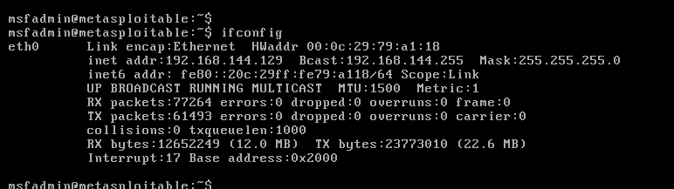
Virtual Lab Environment
TOOLS AND SAFE SETUP
VMware Workstation
Kali Linux
Metasploitable 2
Used to run and manage virtual machines.
Used for Linux practice and network inspection.
Intentionally vulnerable target for authorized lab practice.
• Reviewed NAT, bridged, and host-only networking modes.
• Inspected VM network settings and system configuration.
• Keep Metasploitable isolated from public and untrusted networks.
• Only test systems where explicit authorization is available.
03

Slide 4
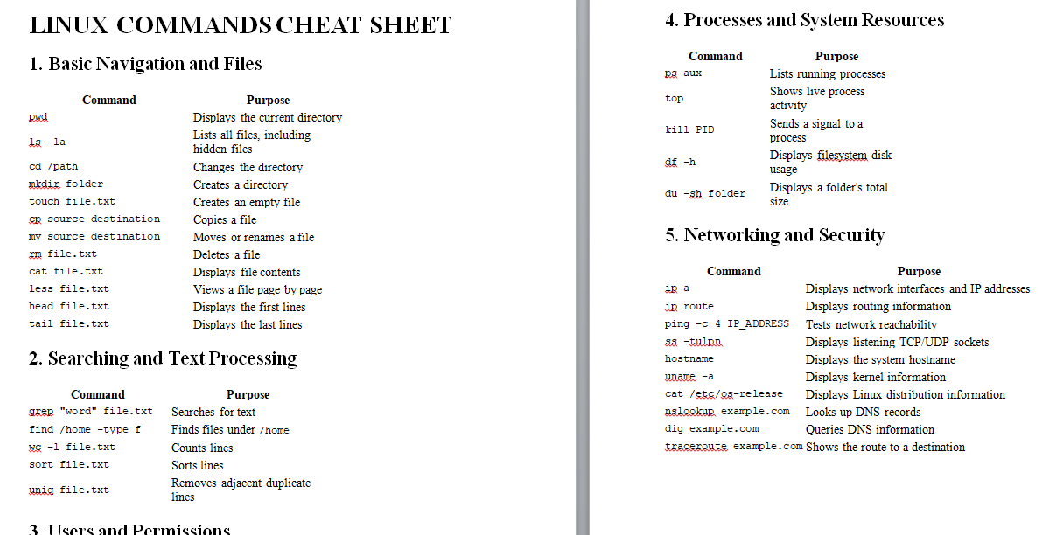
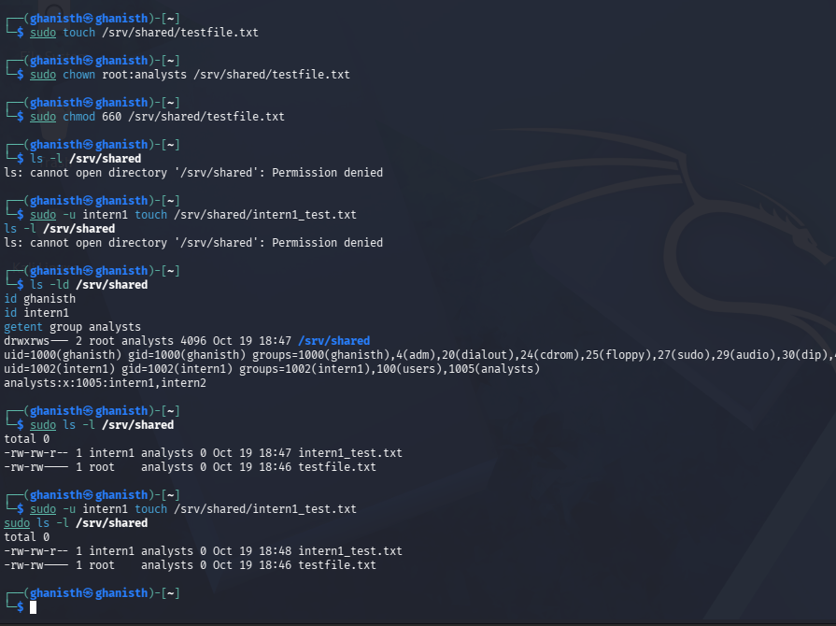
Linux Command-Line Practice
PRACTICAL EXERCISES
• System checks: whoami, hostname, cat /etc/os-release
• Navigation and search: pwd, ls -la, find, grep
• Processes and networking: ps aux, ip a, ip route, ss
• Access control: users, groups, chmod, shared directory permissions
• Automation: configured a cron job and checked its log output
04

Slide 5
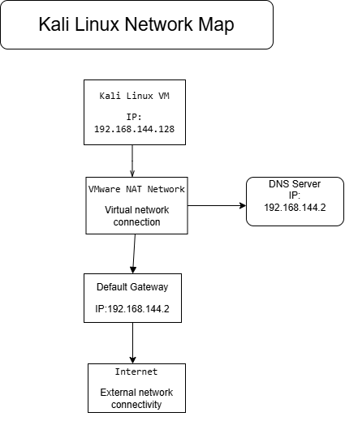
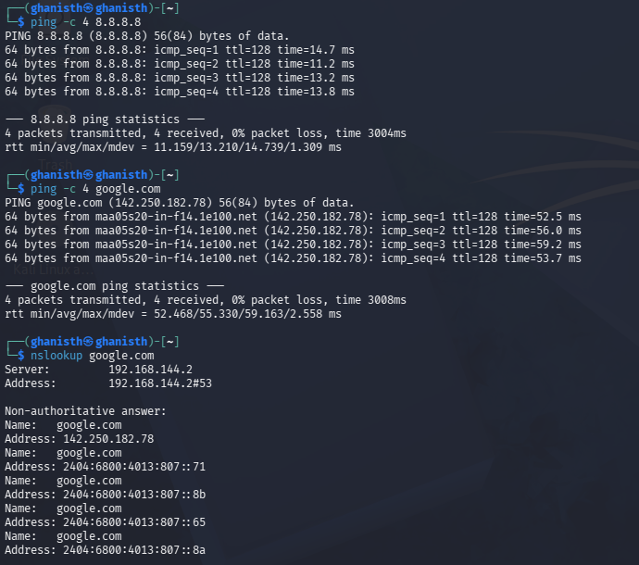
Networking and Connectivity
COMMANDS AND NETWORK MAP
IP & Gateway
DNS
Connectivity
ip a
ip route
cat /etc/resolv.conf
nslookup google.com
ping -c 4 google.com
traceroute google.com
.
05

Slide 6
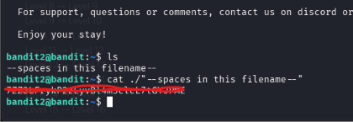
OverTheWire Bandit: Levels 0–10
COMMAND-LINE PROBLEM SOLVING
Files & paths
Search & filter
Data extraction
Special filenames, spaces, hidden files, and file-type identification.
find, grep, sort, and uniq for locating useful information.
strings and Base64 decoding.
• Completed beginner challenges from Level 0 through Level 10, according to the recorded work.
• Prepared a write-up describing the concepts and commands used.
• Kept challenge passwords and credentials out of the report.
06

Slide 7
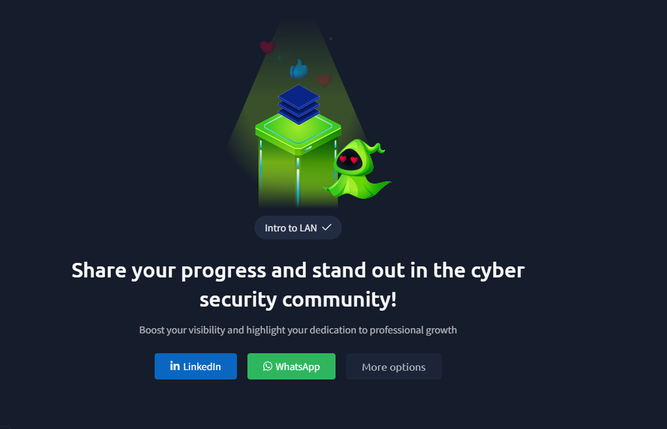
TryHackMe Learning Activities
8 BEGINNER ROOMS
01 Search Skills
02 Learning Cyber Security
03 Linux Fundamentals Part 1
04 What Is Networking?
05 Introductory Networking
06 Networking Concepts
07 Pyramid of Pain
08 Intro to LAN
Evidence location
Findings/TryHackMe/ — each room has its own folder.
07

Slide 8
Key Learnings & Conclusion
WEEK 1 SUMMARY
Technical foundations
Security mindset
Linux commands, access permissions, basic networking, DNS, and connectivity troubleshooting.
Safe lab isolation, authorized testing, careful handling of credentials, and evidence documentation.
Conclusion
Week 1 established a foundation in cybersecurity concepts and practical Linux and networking skills. The lab exercises, Bandit challenges, TryHackMe rooms, and organized documentation provide a starting point for further cybersecurity learning.
Thank You | DG Interns Hub — Week 1 Cybersecurity Internship
08

